Slide 1
Divide and Conquer: Recurrence
Session 08
Henry Lucky, S.Kom. M.Kom.

Slide 2
Outline Materials
Session 08
Solving Recurrences
Substitution method
Recursion tree method
Master method

Slide 3

Solving Recurrences
Ways to solve recurrences
After learning about divide-and-conquer algorithms for merge sort and matrix multiplication, we’ll explore several mathematical tools for solving recurrences-that is, for obtaining asymptotic $Θ$-, $O$-, or $Ω$-bounds on their solutions.
We want simple-to-use tools that can handle the most commonly occurring situations.
But we also want general tools that work, perhaps with a little more effort, for less common cases.

Slide 4
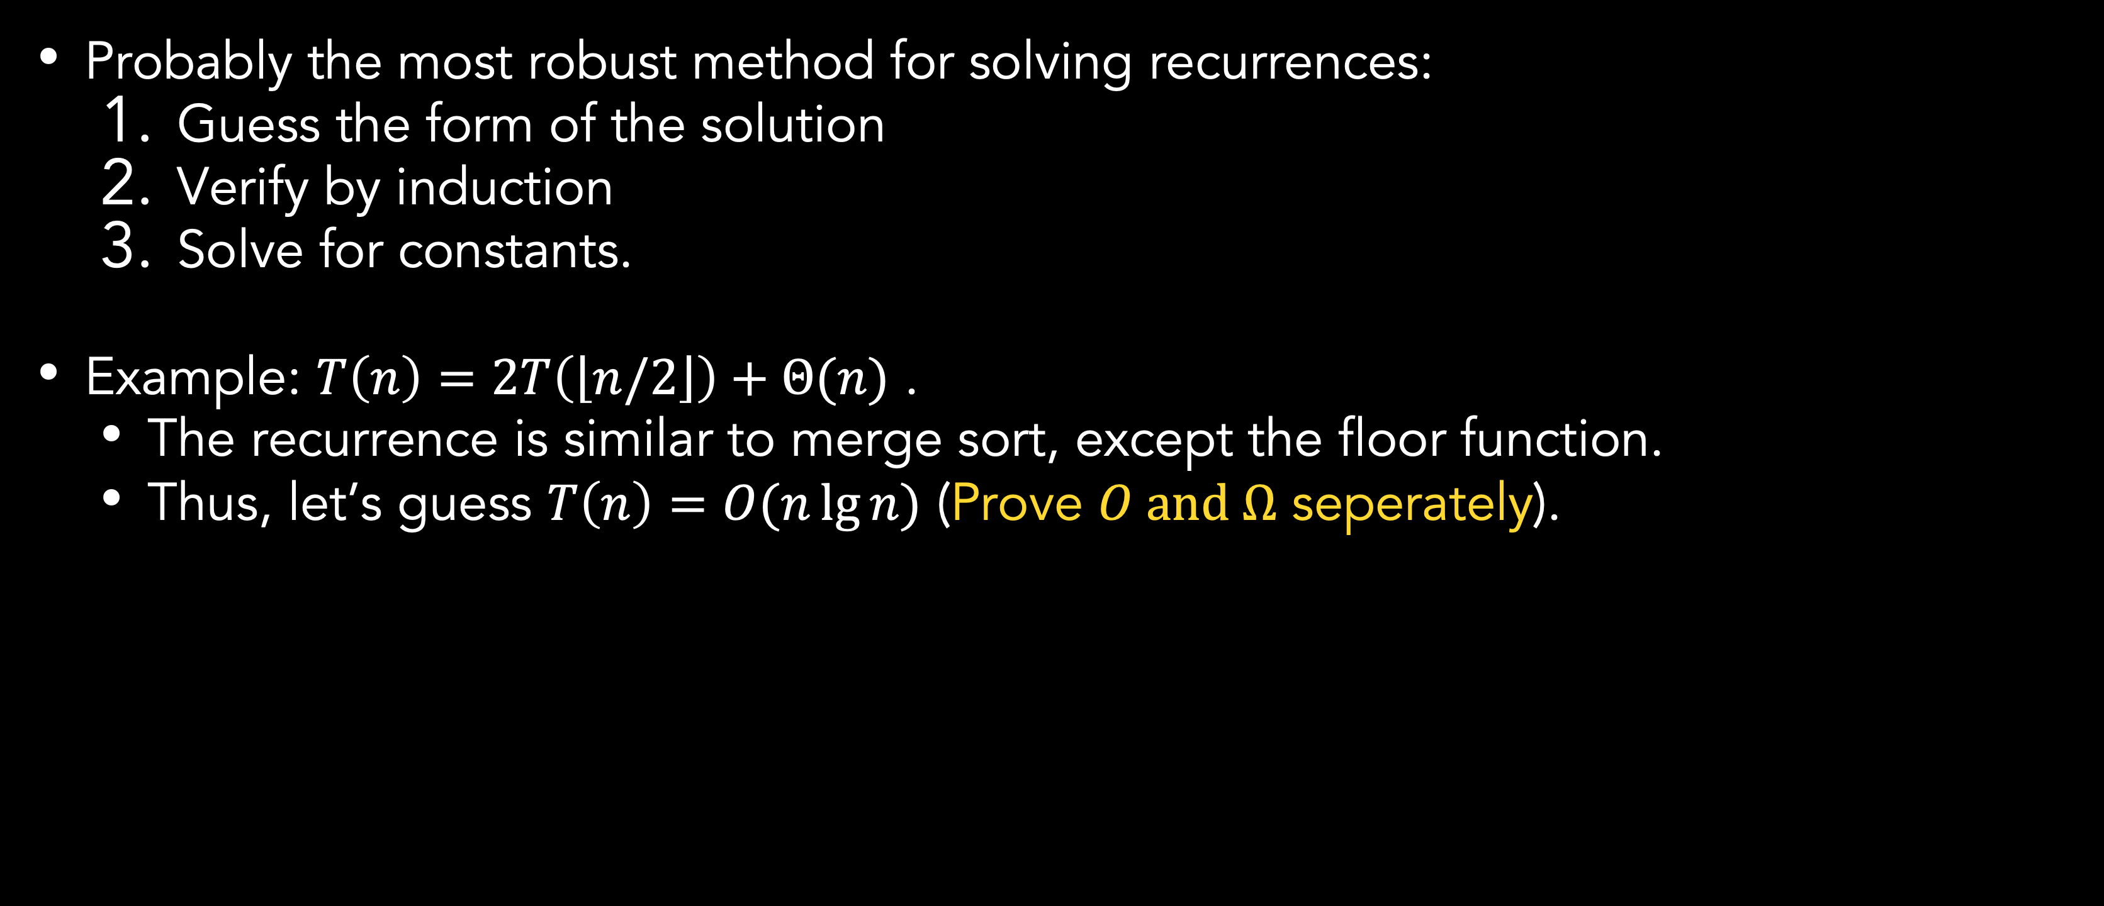
Substitution Method
Problem definition
Probably the most robust method for solving recurrences:
Guess the form of the solution
Verify by induction
Solve for constants.
Example: $T\left(n\right)=2T\left(\left\lfloor n/2\right\rfloor \right)+Θ(n)$ .
The recurrence is similar to merge sort, except the floor function.
Thus, let’s guess $T\left(n\right)=O(n\lg{n})$ (Prove $O and Ω$ seperately).

Slide 5
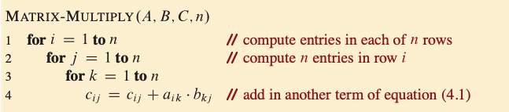

Matrix multiplication
Problem definition
Based on the procedure, we can tell that it operates in ${Θ(n}^{3})$, because triply nested for loops runs for exactly n iterations and line 4 takes constant time.
Even if we add ${Θ(n}^{2})$ time for initializing C to 0, the running time is still ${Θ(n}^{3})$.

Slide 6
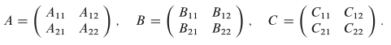
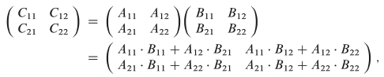

Matrix multiplication
Simple divide-and-conquer algorithm
Let’s see how to compute the matrix product $A∙B$ using divide-and-conquer. For $n>1$, the divide step partitions the $n×n$ matrices into four $n/2×n/2$ submatrices.
We’ll assume that n is an exact power of 2, so that as the algorithm recurses, we are guaranteed that the submatrix dimensions are integer.
The divide step views each of the $n×n$ matrices $A, B, C$ as four $n/2×n/2$ submatrices:
Then, we can write the matrix product as:
We can see it has 4 equations which consist of 4 additions and 8 multiplications of n/2 X n/2 submatrices

Slide 7

Matrix multiplication
Simple divide-and-conquer algorithm
To transform the equation to an algorithm, there are two common approaches for implementing the matrix partitioning:
Allocating temporary storage and copying all submatrices which take $Θ(n^{2})$ time, since ${3n}^{2}$ elements are copied
Index calculations which takes $Θ(1)$ time, since it only involves arithmetic on the location information
Going forward, we’ll assume that index calculations are used and that partitioning can be performed in $Θ(1)$ time.

Slide 8
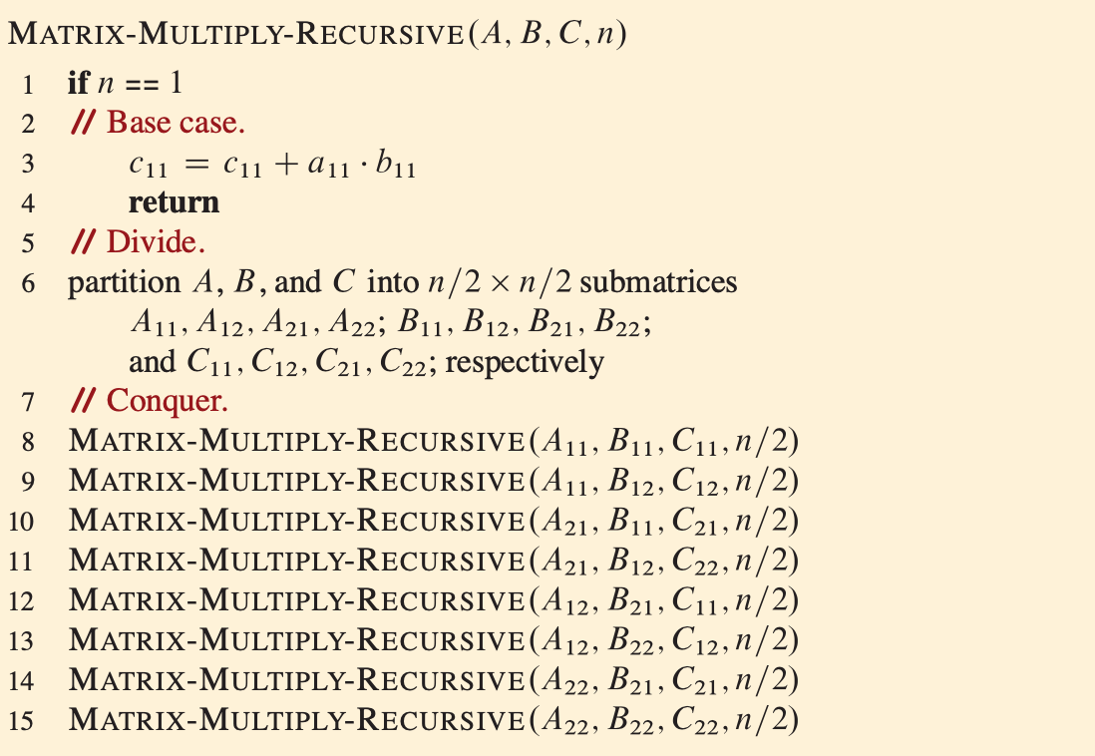
Matrix multiplication
Simple divide-and-conquer algorithm

Slide 9

Matrix multiplication
Simple divide-and-conquer algorithm
In the base case, when n=1, line 3 performs just the one scalar multiplication and one addition, which means that $T\left(n\right)=Θ(1)$. As is our convention for constant base cases, we can omit this base case in the statement of the recurrence.
The recursive case occurs when n>1. As discussed, we’ll use index calculations to partition the matrices in line 6, taking $Θ(1)$ time. Lines 8-15 recursively call MATRIX-MULTIPLY-RECURSIVE a total of eight times.
The first four recursive calls compute the first terms of equations in matrix before and the subsequent four recursive calls compute and add in the second terms.
Because each recursive call multiplies two n/2 X n/2 matrices, thereby contributing $T\left(n/2\right)$ to the overall running time, the time taken by all eight recursive calls is $8T\left(n/2\right)$.
There is no combine step, because the matrix is updated in place, thanks to index calculations.

Slide 10

Matrix multiplication
Simple divide-and-conquer algorithm
Therefore, our recurrence for the running time of MATRIX-MULTIPLY-RECURSIVE is
$$T\left(n\right)=8T\left(n/2\right)+Θ(1)$$
We will see later that the recurrence above has the solution $Θ(n^{3})$.
Why is the $Θ(n^{3})$ solution to this recurrence so much larger than the $Θ(n\lg{n})$ solution to the merge-sort recurrence? After all, the recurrence for merge sort contains a $Θ(n)$ term, whereas the recurrence for recursive matrix multiplication contains only a $Θ(1)$ term.
To answer that, we can look into the recursion trees.

Slide 11
Strassen’s algorithm for matrix multiplication

Slide 12

Strassen’s algorithm for matrix multiplication
The Theory behind
It’s hard to imagine that any matrix multiplication algorithm could take less than $Θ(n^{3})$ time, since the natural definition of matrix multiplication requires $n^{3}$ scalar multiplications.
1969, when V. Strassen published a remarkable recursive algorithm for multiplying matrices.
Strassen’s algorithm runs in $Θ(n^{\lg{7}})$ time. Since lg 7 = 2.8073549… the algorithm runs in $O(n^{2.81})$ time, which is better asymptotically than the $Θ(n^{3})$.
The key to Strassen’s method is to use the divide-and-conquer idea from the MATRIX-MULTIPLY-RECURSIVE procedure, but make the recursion tree less bushy.
Instead of performing eight recursive multiplications of matrices, Strassen’s algorithm performs only seven.
The cost of eliminating one matrix multiplication is several new additions and subtractions of matrices, but still only a constant number.

Slide 13

Strassen’s algorithm for matrix multiplication
The Theory behind
To understand the nature of Strassen’s algorithm, suppose you want to calculate $x^{2}−y^{2}$ from $x$ and $y$.
The straightforward calculation would be $(x∙x)−(y∙y)$, which has two multiplications and one subtraction (or negative addition).
However, we also has the algebra trick $x^{2}−y^{2}=$ $(x+y)∙(x−y)$, which has one multiplication and two additions.
Both approach still requires three scalar operations.
If $x$ and $y$ are large matrices, however, the cost of multiplying outweighs the cost of adding, in which case the second method outperforms the first, although not asymptotically.

Slide 14

Strassen’s algorithm for matrix multiplication
How it works
Overall, there are 4 steps in Strassen’s algorithm:
For base case, perform a single scalar multiplication and a single scalar addition. Otherwise, partition the input matrices A and B and output matrix C into submatrices. This step takes $Θ(1)$time by index calculation, just as in MATRIX-MULTIPLY-RECURSIVE.
Create ten n/2 X n/2 matrices $S_{1},S_{2},…, S_{10}$, each of which is the sum or difference of two submatrices from step 1. Create and zero the entries of seven n/2 X n/2 matrices $P_{1},P_{2},…, P_{7}$ to hold seven n/2 X n/2 matrices products. This step takes $Θ(n^{2})$ time.
Recursively compute seven matrix product $P_{1},P_{2},…, P_{7}$ using submatrices from step 1 and matrices $S_{1},S_{2},…, S_{10}$ from step 2, taking $7T\left(n/2\right)$ time.
Update the four submatrices $C_{11},C_{12},C_{21}, C_{22}$ of the result matrix C by adding or subtracting various $P_{i}$matrices, which takes $Θ(n^{2})$ time.

Slide 15
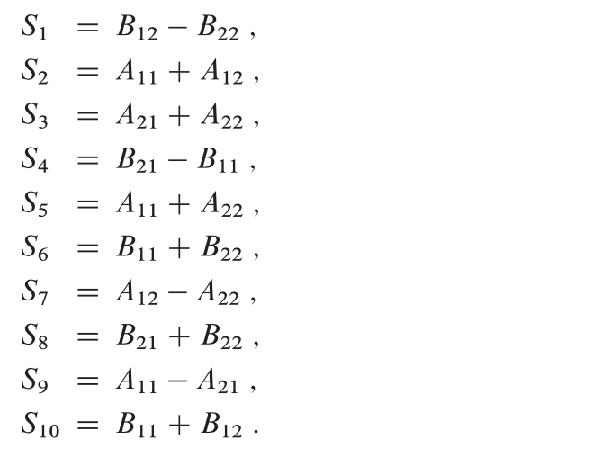
Strassen’s algorithm for matrix multiplication
How it works: Step 2
Step 1 is similar to the MULTIPLY-RECURSIVE procedure.
For step 2, this is the detail of 10 matrices created:

Slide 16
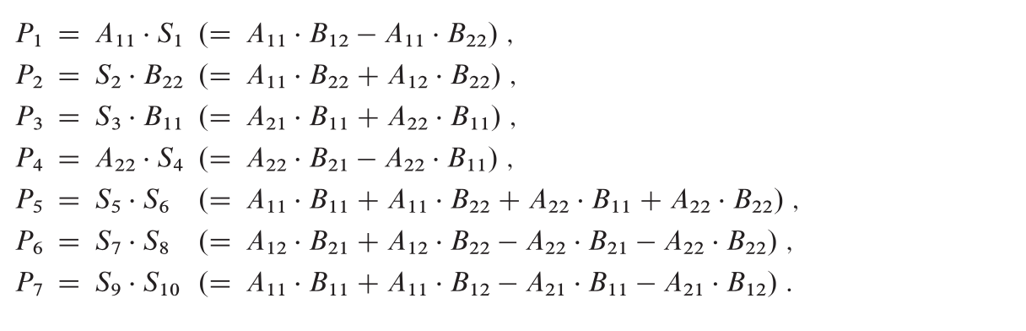
Strassen’s algorithm for matrix multiplication
How it works: Step 3
Step 3 recursively multiplies n/2 X n/2 matrices 7 times to compute the following matrices, each of which is the sum or difference of products of A and B submatrices:

Slide 17
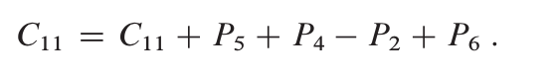
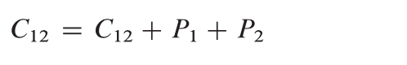
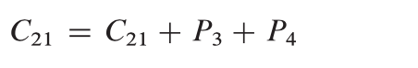
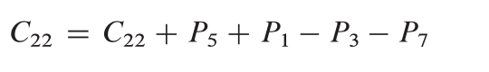

Strassen’s algorithm for matrix multiplication
How it works: Step 4
Update the four submatrices $C_{11},C_{12},C_{21}, C_{22}$ of the result matrix C by adding or subtracting various $P_{i}$matrices:

Slide 18

Strassen’s algorithm for matrix multiplication
How it works: Step 4
Hence, we obtain the following recurrence for the running time of Strassen’s algorithm:
$$T\left(n\right)=7T\left(n/2\right)+Θ(n^{2})$$
Which has the solution:
$$T\left(n\right)=Θ(n^{\lg{7}})=O(n^{2.81})$$

Slide 19
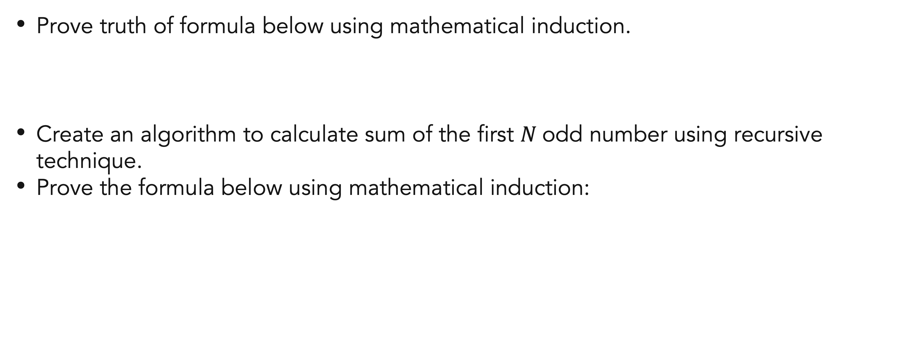
Exercises
Mathematical induction
Prove truth of formula below using mathematical induction.
Create an algorithm to calculate sum of the first $N$odd number using recursive technique.
Prove the formula below using mathematical induction:

Slide 20
References
Thomas H. Cormen. (2022). Introduction to algorithms: Fourth edition. The MIT Press. Chapter 3.

Slide 21
Thank you
Mathematical Induction And Recursive Function
September, 2023

